Slide 1

IE HOUSE
Jhojan Esteban Gómez Garzón
Yeferson Alejandro Valencia Garzón

Slide 2
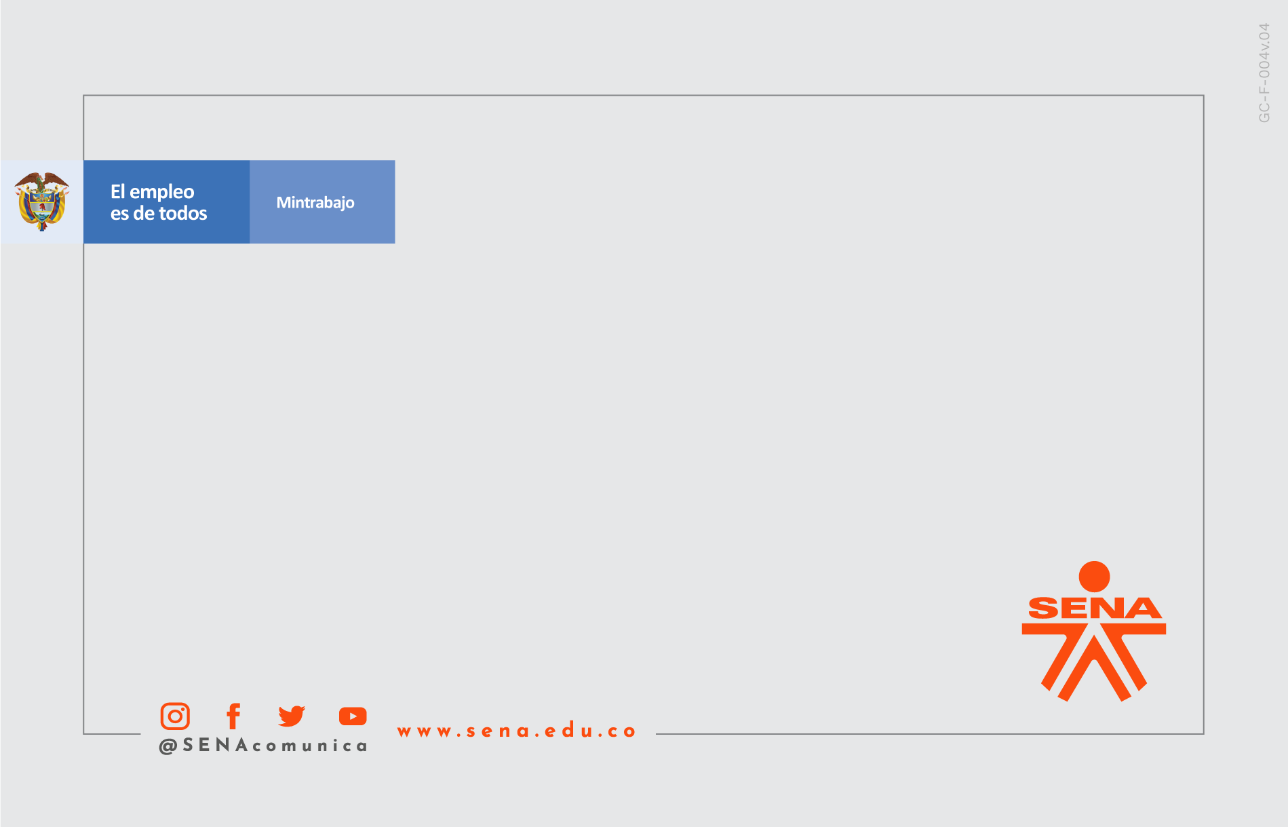

IE HOUSE

Slide 3

Problem
The problem is identified by observing that in the SENA and in the homes there is not a system that allows to manage the bulbs from any distance there is not a system that allows to control the energy consumed by that bulbs

Slide 4

Justification
The need identified to develop a system that allows to manage the on and off of bubls intelligently and allows to maintain an energy control by providing reports and means capable of promoting energy saving afficiently and and effectively

Slide 5
General Objetive
Develop a system that allows to manage bulbs in an intelligent and efficient way, and additionally motivate homes and stablishments to be part of the fourth Industrial Revolution

Slide 6

Specific Objetives
Promote the adaptation of homes to the new industrial revolution.
Facilitate access of people with reduced mobility to the control of homes lights
Point to the internet of everything and the new tecnologies that will come in the long term

Slide 7

50%
Texto corto descriptivo a
2 o 3 líneas.

Slide 8
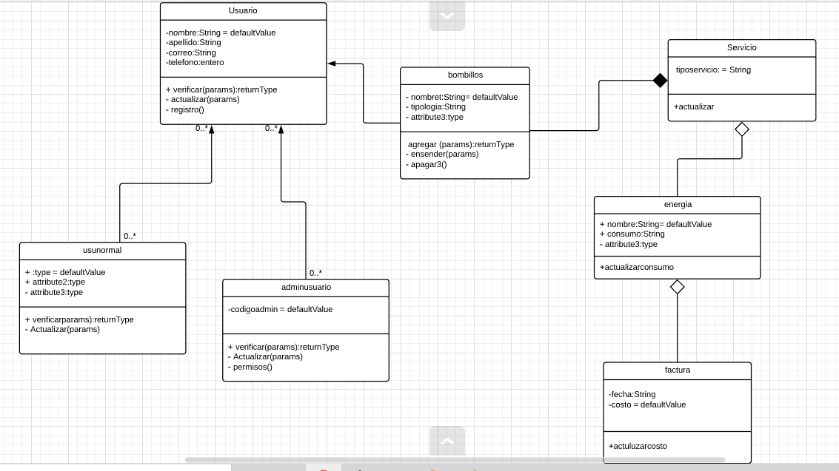
Diagrama de clases

Slide 9
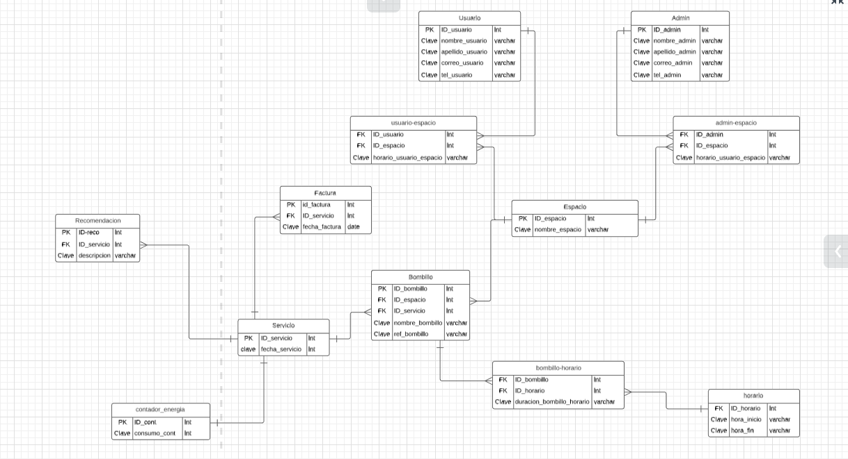
Modelo Relacional
Marca externa

Slide 10
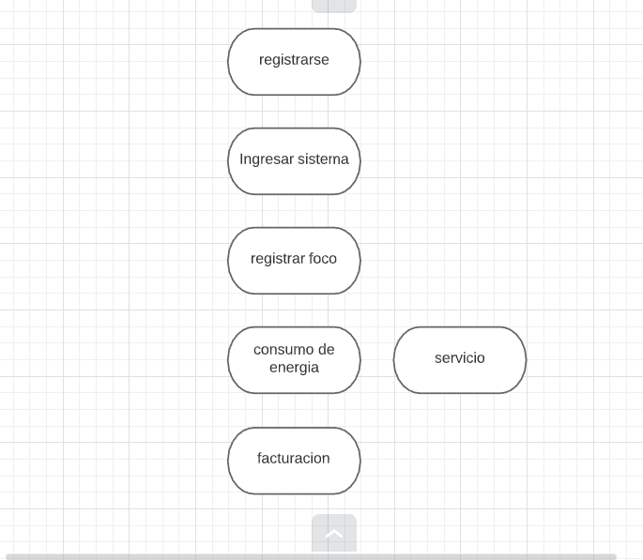
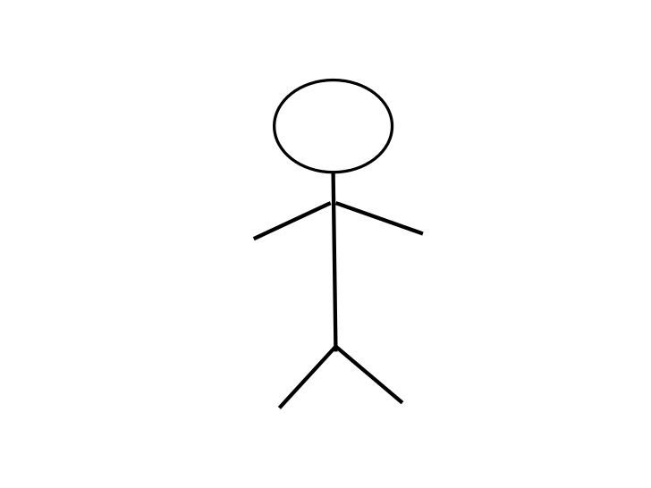
De casos de uso
Marca externa

Slide 11


Slide 12
Título
Presentación
Marca externa

Slide 13

Título
Textos en Calibri, en gris oscuro. Puede reemplazar la imagen por una fotografía alusiva al tema que se está tratando. Al reemplazar la foto tenga cuidado de colocarlo debajo del logo del SENA, que debe ir en la esquina superior derecha en blanco.
Marca externa

Slide 14
Título
El tamaño del logo de la marca externa no debe superar el tamaño del logo SENA.
Marca externa

Slide 15
Para las diapositivas con fondo de color naranja, es recomendable colocar la versión blanca del logo de la marca externa.
Marca externa

